Slide 1










MESSAGE CENTER PROJECT
Embedded Fresher Training – July 8th, 2022

Slide 2
Contents
01 Planning and Requirement Analysis
02 Design
03 Development
04 Testing
05 Problems

Slide 3
Analysis
Customer requirements:
No Login, No Database, No History
Select a role when app starts
Apps do not poll for incoming data
No limited number of App connected to Message Center

Slide 4
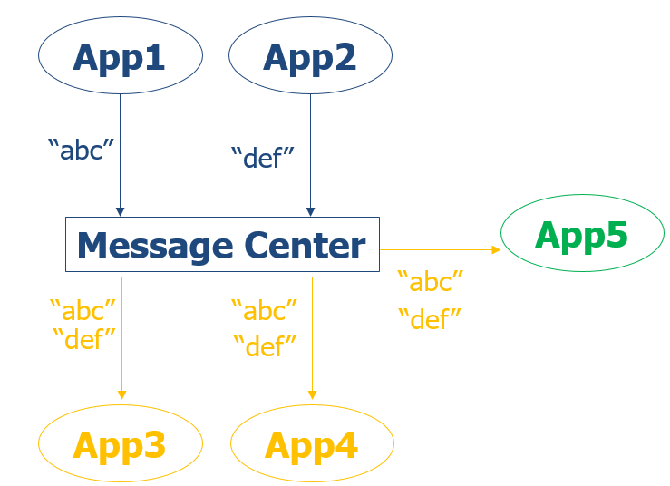
Analysis
Customer requirements:
No Login, No Database, No History
Select a role when app starts
Apps do not poll for incoming data
No limited number of App connected to Message Center

Slide 5
Analysis
Technical requirements
Server | Client
able to receive from and send message to clients no limited number of clients connected to no database, no history be aware of new client use multi-thread | able to connect to the server no login able to select role when app starts has log out option 3 roles: listener: only receive messages from the time of connecting to the server successfully Not able to poll server for incoming data talker: only send messages to server listener and talker: do both things UI: use command line received message section and input message section are seperated

Slide 6
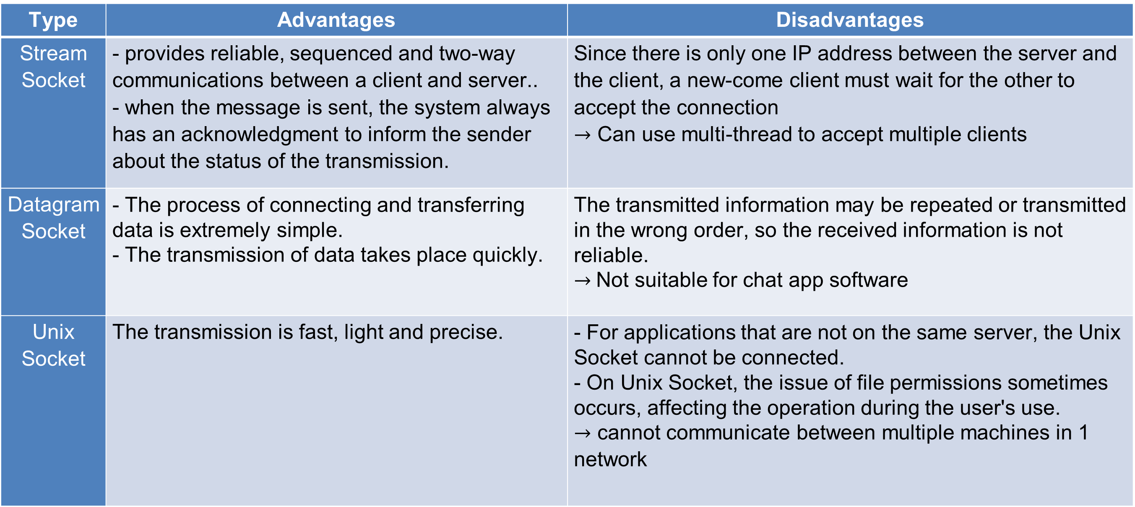
Analysis
Technical requirements
Type | Advantages | Disadvantages
Stream Socket | - provides reliable, sequenced and two-way communications between a client and server.. - when the message is sent, the system always has an acknowledgment to inform the sender about the status of the transmission. | Since there is only one IP address between the server and the client, a new-come client must wait for the other to accept the connection $→$ Can use multi-thread to accept multiple clients
Datagram Socket | - The process of connecting and transferring data is extremely simple. - The transmission of data takes place quickly. | The transmitted information may be repeated or transmitted in the wrong order, so the received information is not reliable. $→$Not suitable for chat app software
Unix Socket | The transmission is fast, light and precise. | - For applications that are not on the same server, the Unix Socket cannot be connected. - On Unix Socket, the issue of file permissions sometimes occurs, affecting the operation during the user's use. $→$ cannot communicate between multiple machines in 1 network

Slide 7
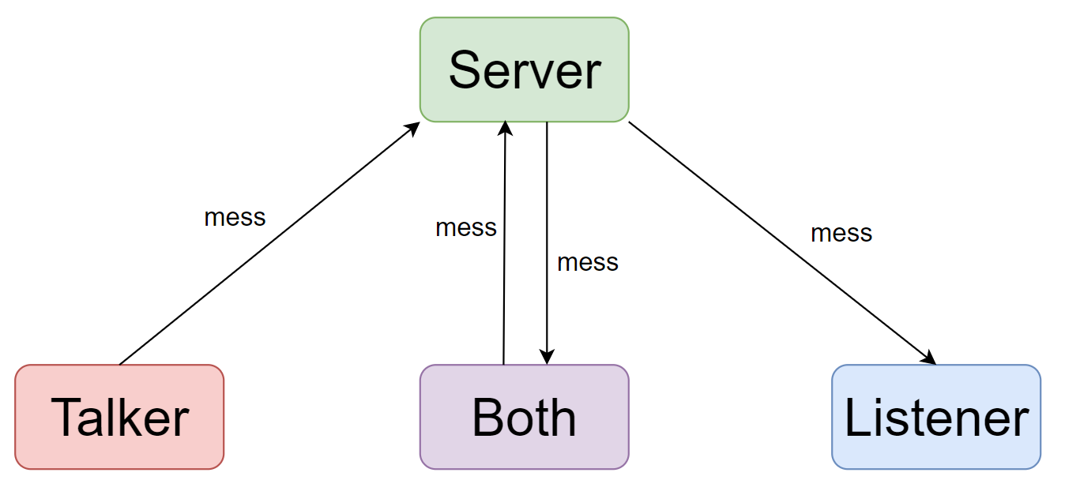
Design
System overview

Slide 8
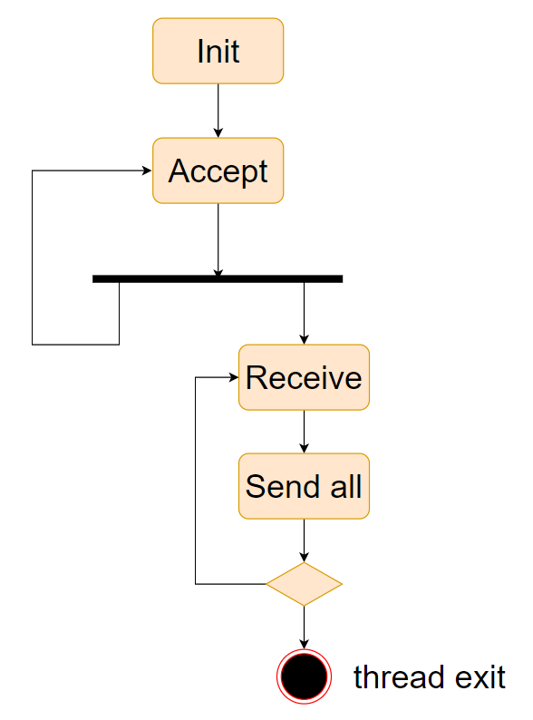
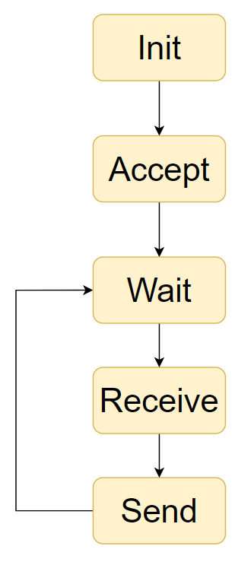
Design
High level design
Server

Slide 9
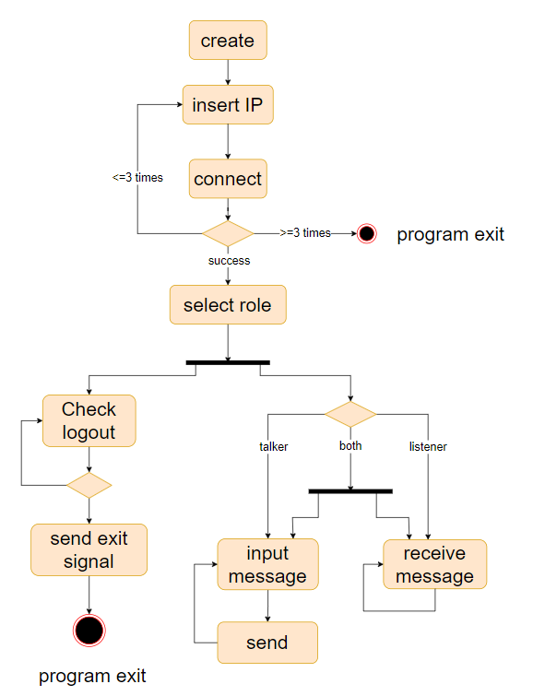
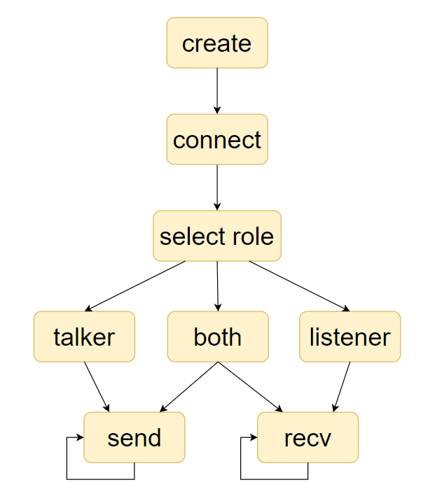
Design
High level design
Client

Slide 10
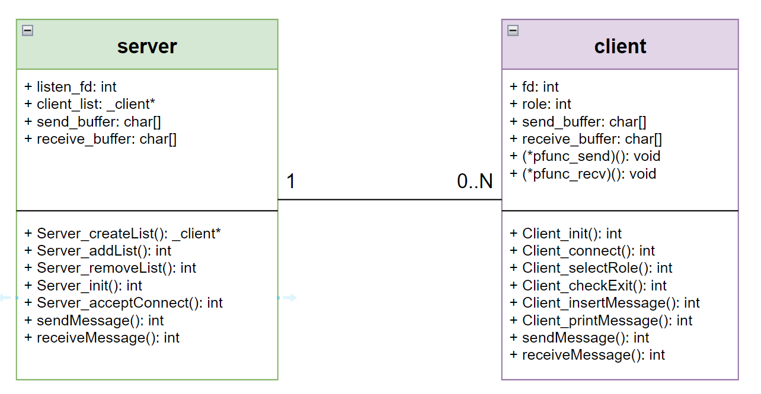
Design
Low level design
Class diagram

Slide 11
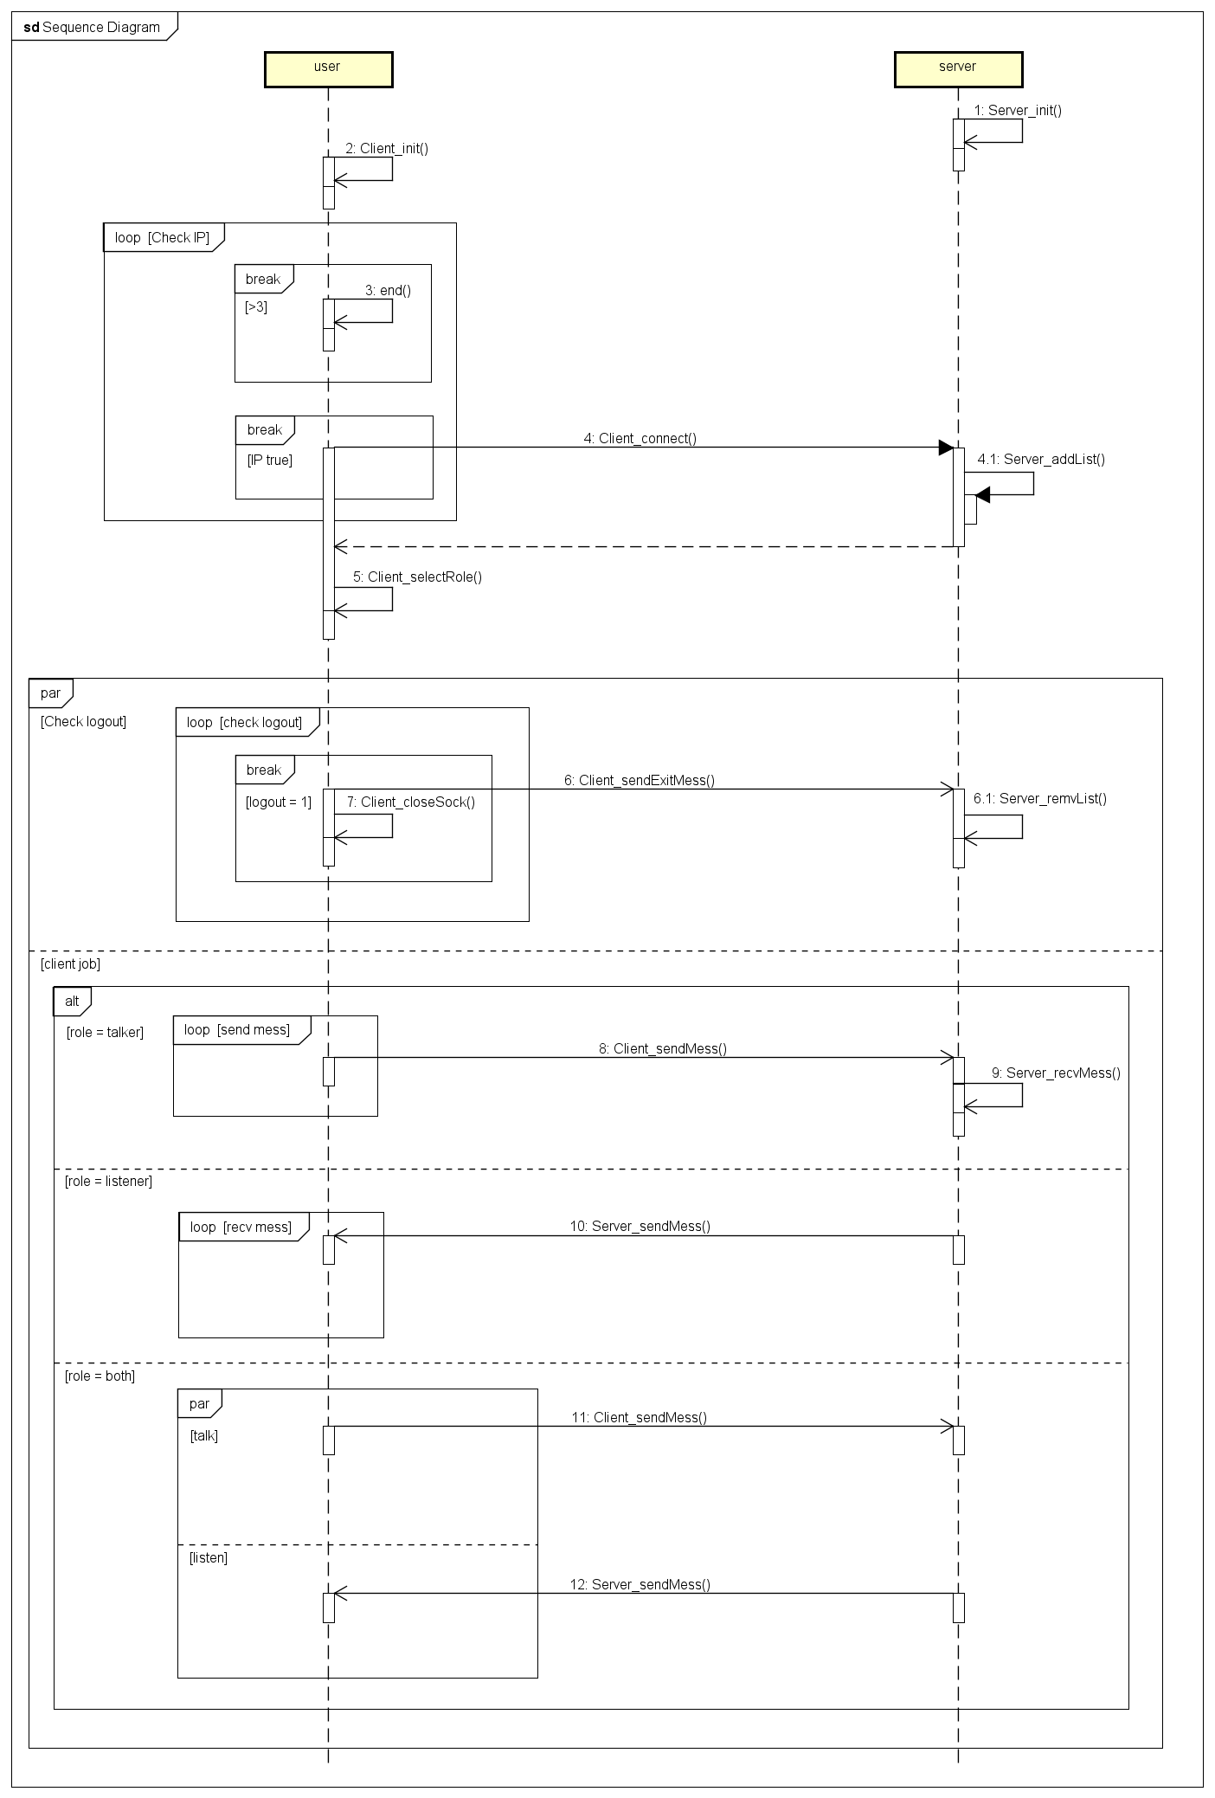
Design
Low level design
Sequence diagram

Slide 12
Development

Slide 13
Development
Project tree
Project
Main program
msg_client.c
msg_server.c
Library
Makefile
server.h
client.h
common.h
Github: Tommy-ttan/message-project-Humax (github.com)

Slide 14
Testing

Slide 15
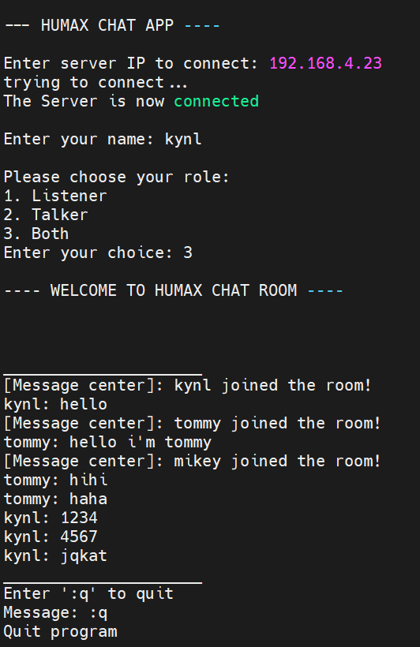
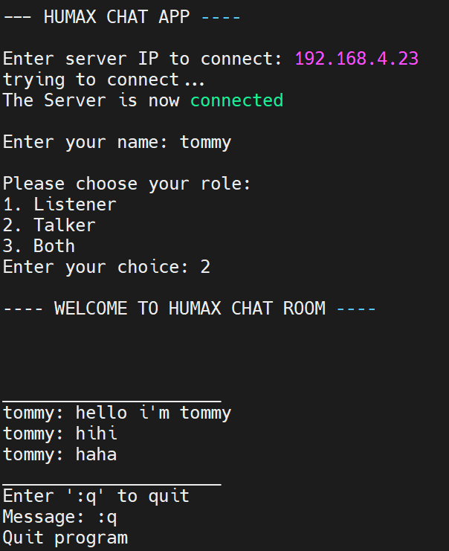
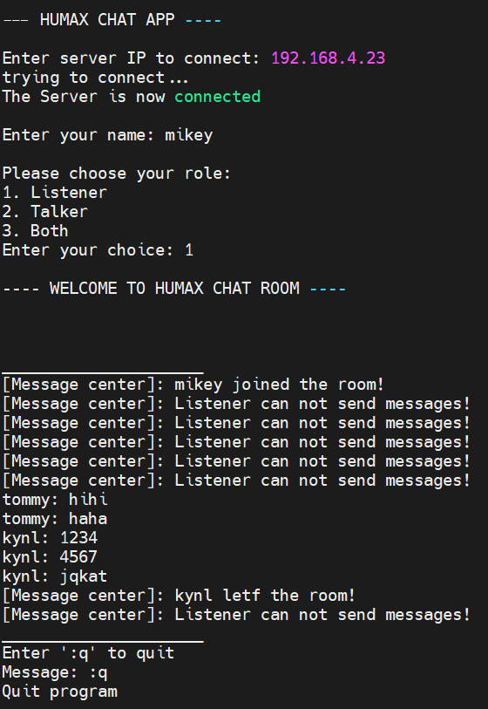
Testing
Client log
Both
Talker
Listener

Slide 16
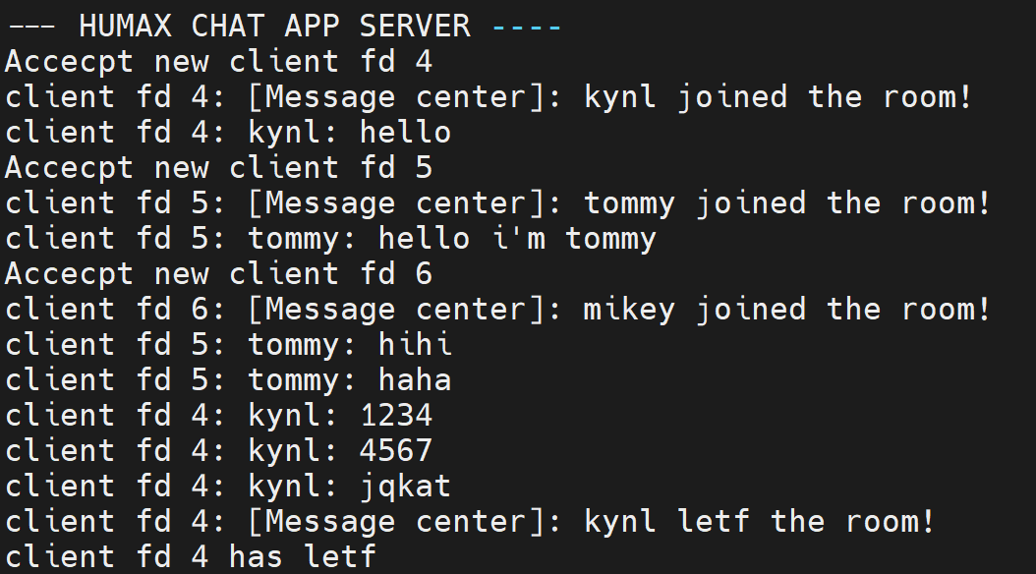
Testing
Server log

Slide 17
Problems

Slide 18
Problems
Can not deploy in virtual machines
The client apps do not exit automatically when the server shuts down
The maximum number of clients has not been quantified yet

Slide 19
THANK YOU!

